Slide 1

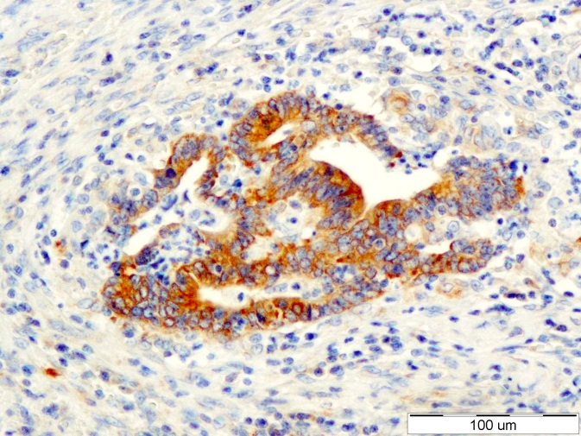
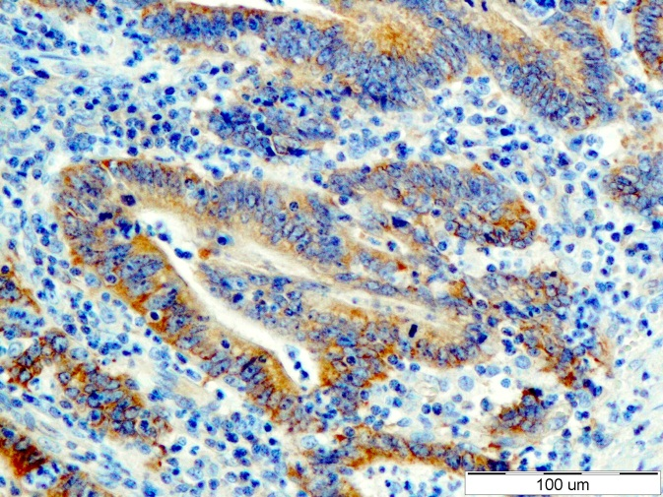
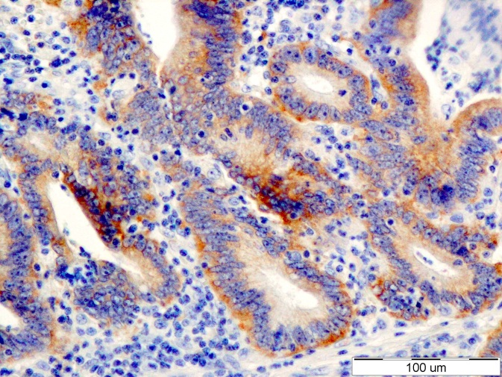
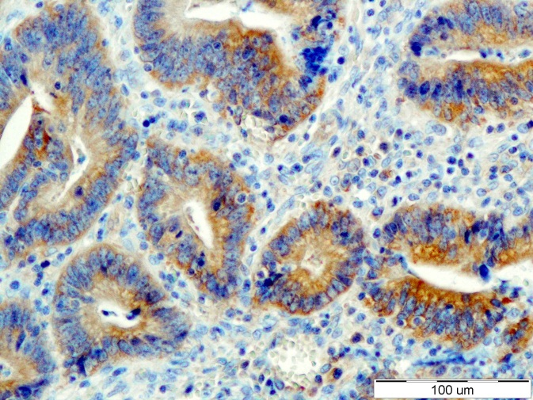
ReliaTech GmbH
Anti-human VEGF-C #9E7
(Cat. #101-M90)
Immunohistochemistry with paraffin-embedded section of human colon carcinoma tissue.
The experiment was performed by Dr. Paula Bartosz, Wroclaw Medical University
Departmetnt of Histology and Embriology; ul. Chalubinskiego 6a
50-368 Wroclaw
http://www.reliatech.de / orders@reliatech.de

Slide 2
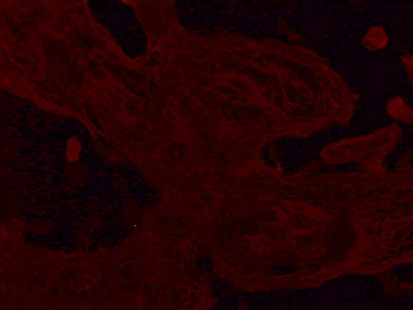
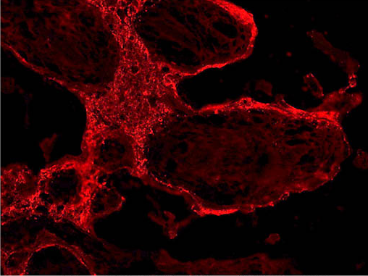
IHC with cryo-sections using RELIATech‘s
monoclonal anti-human PlGF antibody
clone #342/3B10
Human Placenta Tissue
Control
Anti-human PlGF #3B10
The experiment was performed by PD. Dr. Jörg Wilting, Pädiatrie I, Zentrum für Kinderheilkunde und Jugendmedizin in Göttingen, Germany.

